Slide 1
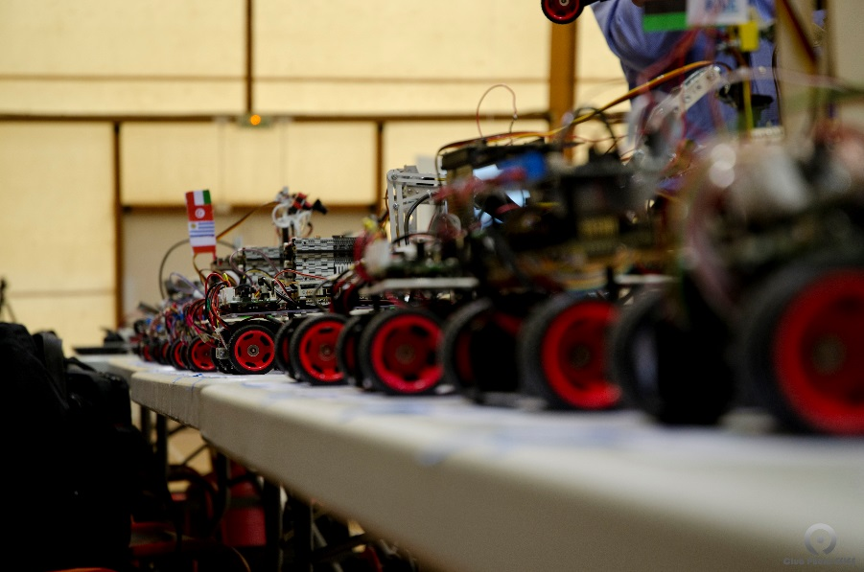
01
Intelligent Model Vehicle
Team ‘We DREAMED VICTORY’
2011012186 DaeHyun Kim
2011012249 JungHoon Kim
2011012432 HongKyu Lee
2011012313 HyeunSeop Song

Slide 2
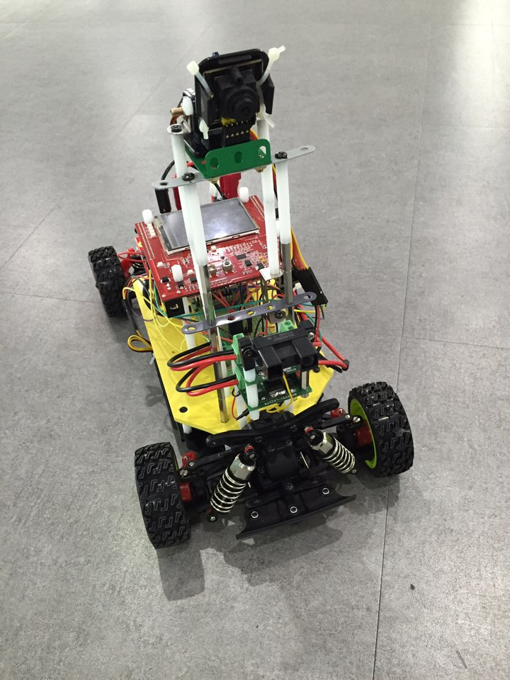


Introduction
02
Design Concept
MATLAB
Code Generation
Simulink

Slide 3
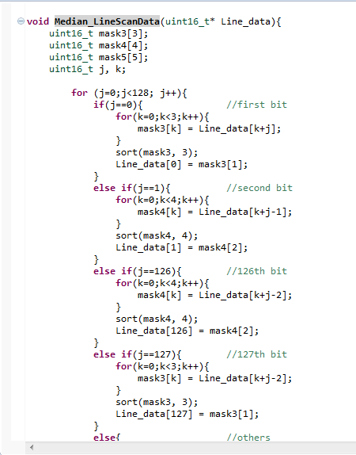
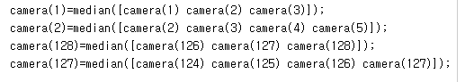
SW Implementation
03
MatLab Function
Median
Filter

Slide 4
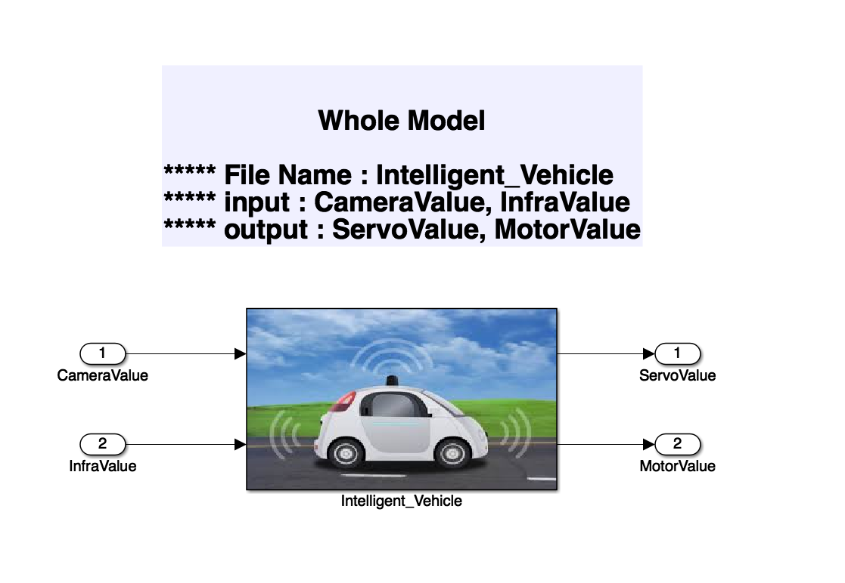
SW Implementation
04
Simulink Block Diagram

Slide 5
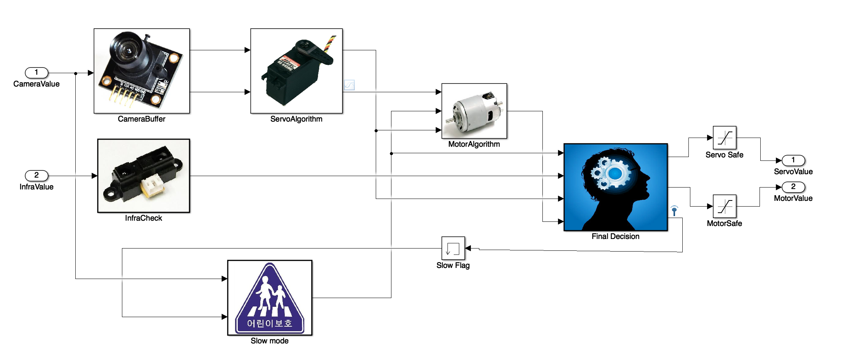
SW Implementation
05
Modularization

Slide 6
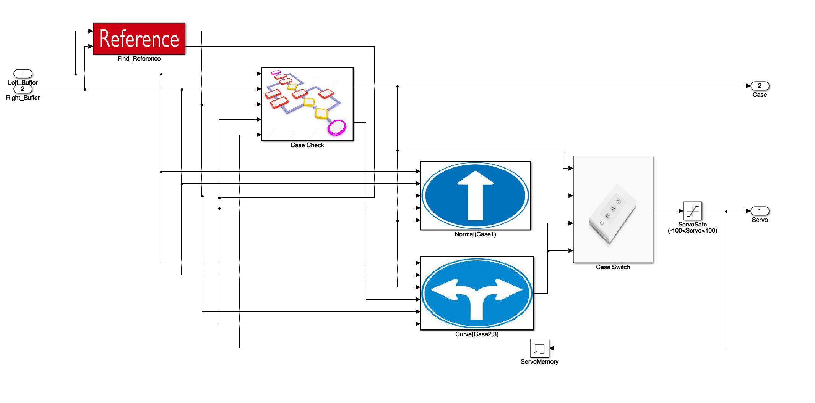
SW Implementation
06
Case Categorization
Case check

Slide 7
SW Implementation
07
Test Driven Development

Slide 8
SW Implementation
08
Test Driven Development
300
200
100

Slide 9
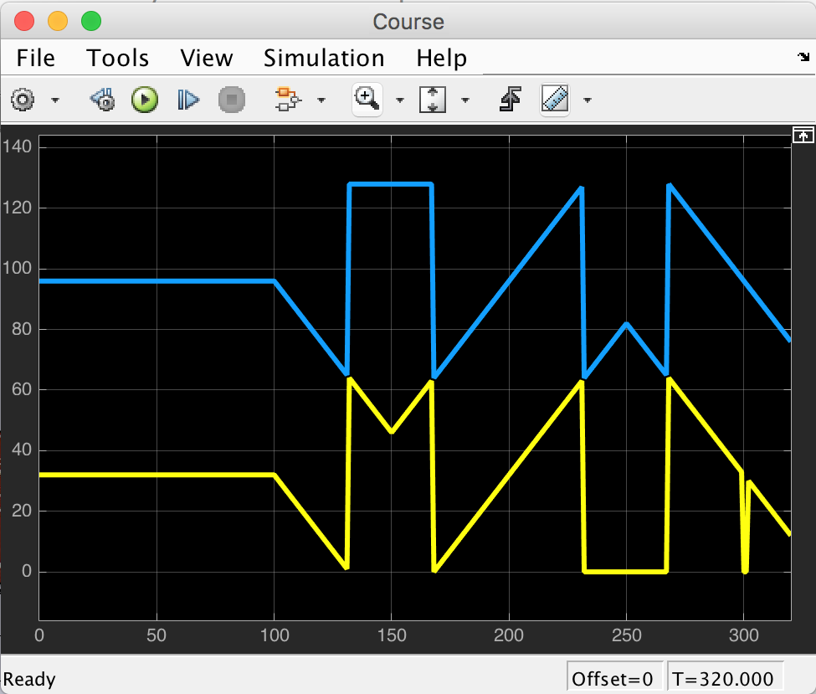
SW Implementation
09
Test Driven Development

Slide 10
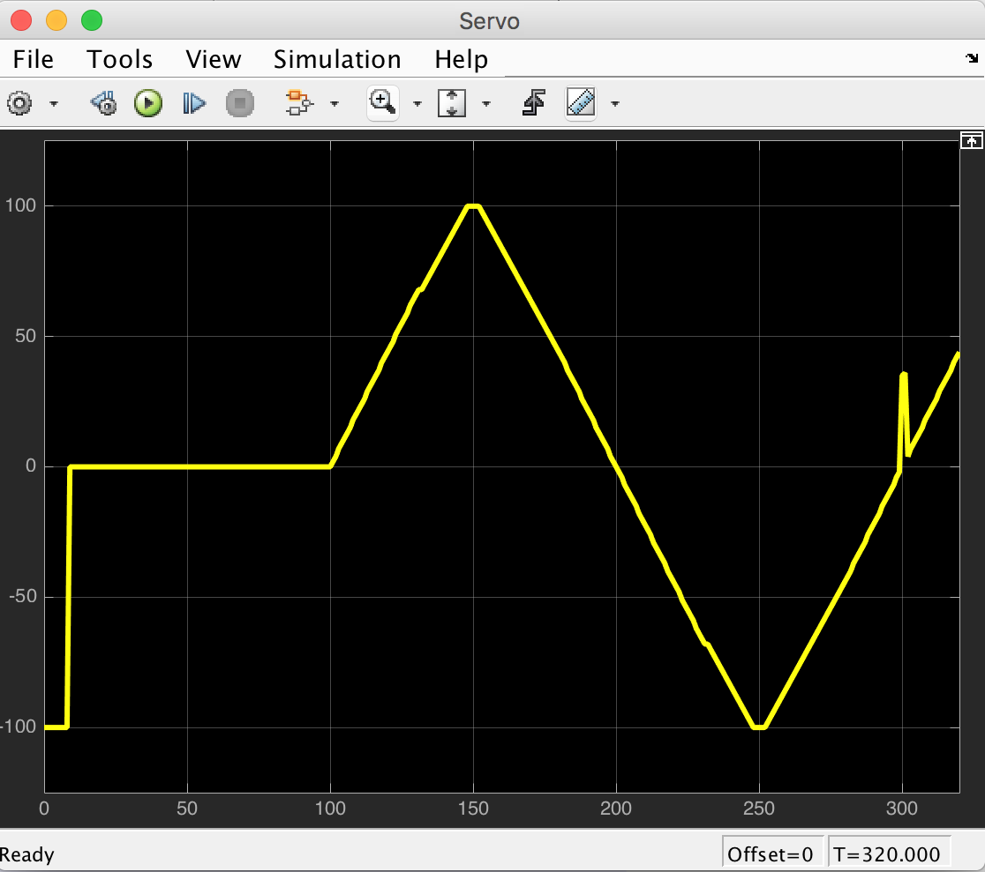
SW Implementation
10
Test Driven Development
Servo Value

Slide 11
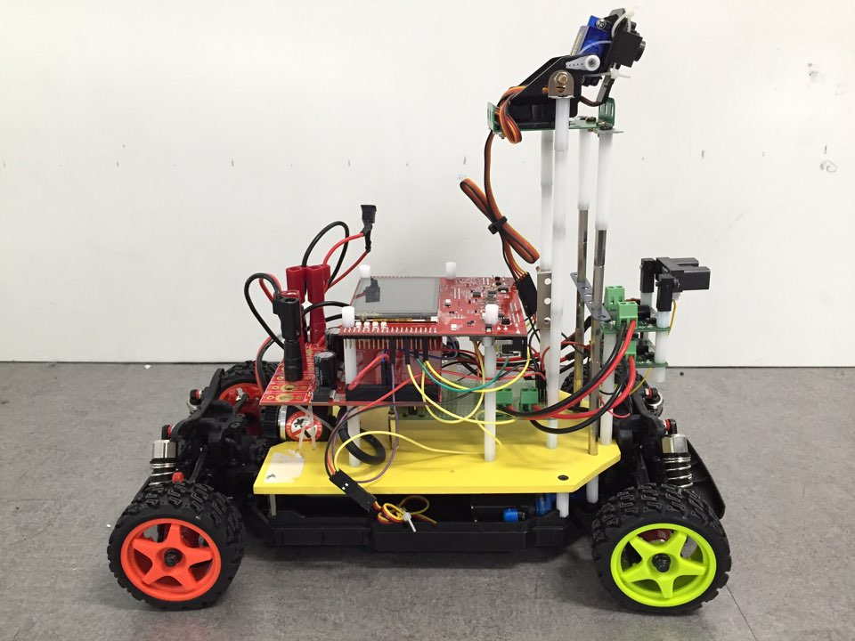
SW Implementation
11
Optimization

Slide 12
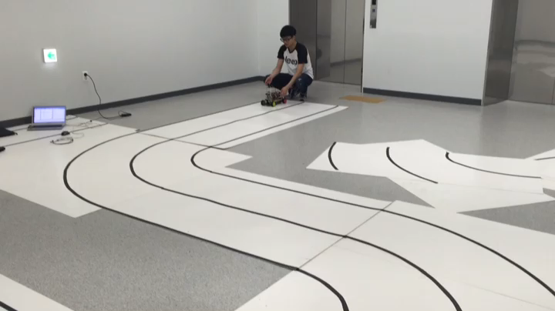
SW Implementation
12
Video

Slide 13
Team ‘We DREAMED VICTORY’
Thank you

